Slide 1
WRJ and The UN
Hand in Hand For Tikkum Olam

Slide 2
Pay equity
Violence Against Women
Reproductive Rights
Economic Justice & Labor Rights
Israel & Religious Pluralism
Immigration and Refugee Reform
WRJ PRIORITY ISSUES

Slide 3
Women of Reform Judaism (WRJ) strengthens the voice of women worldwide and empowers them to create caring communities, nurture congregations, cultivate personal and
spiritual growth, and advocate for and
Promote progressive Jewish values

Slide 4
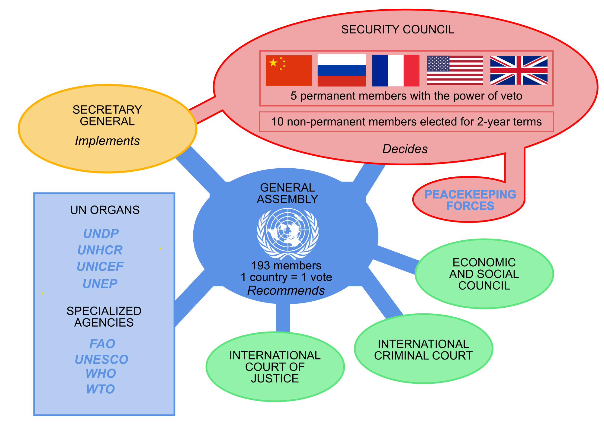

Slide 7
Sometimes the smallest step in the right direction ends up being the biggest step of your life.
Tiptoe if you must-But take the step

